Slide 1
Take control of multi-platform push notifications with Azure Notification Hubs
Wednesday, March 28, 2018
Ottawa Cloud Tech Meetup
Lixar HQ
Vivien Chevallier

Slide 2
Summary
Sending push notifications
Azure Notification Hubs, main features of the service
Configuration and deployment

Slide 3
Sending push notifications

Slide 4
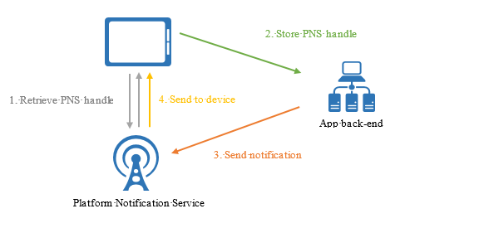
Principle
Sending push notifications

Slide 5
Sending push notifications
Write your own library
Use a third party library; Ex: PushSharp
Complexity increasing with the number of platforms
Take maintenance into account (Platforms change)
Scalability of the implementation
Support fast scalability

Slide 6
Azure Notification Hubs

Slide 7
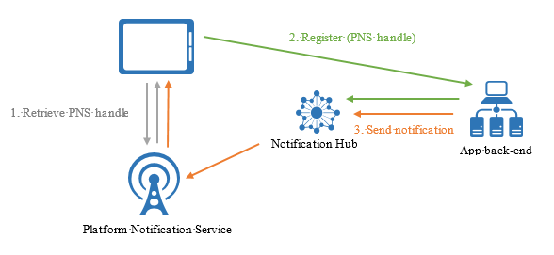
Principle
Azure Notification Hubs

Slide 8
Main features of the service
Azure Notification Hubs
Multi-plateform
Apple iOS, Android, Windows Universal, Windows Phone, Kindle, Baidu, Xamarin (iOS & Android), Chrome Apps and Safari
One API call = notifications to 1 or multiple platforms
Cloud or On-premise
Send 1 million push notifications per minute

Slide 9
Main features of the service
Azure Notification Hubs
Free
  1 million push notifications per month
  500 registered devices
SDK for the following les platforms: .NET, Java, PHP, Python and Node.js

Slide 10
Devices registration
Azure Notification Hubs
From the device itself
From the backend
Benefits of registering from the backend
  More control
  User Authentication
  Create or modify tags according to the application logic

Slide 11
Devices registration
Azure Notification Hubs
Via Registration or Installation
Installation is now prefered, most recent and effective way
No risk of duplication in the device registration
Easier to target a specific device with the tag $InstallationId
An installation contains:
  Id
  Platform
  Handle PNS (PushChannel)
  Tags

Slide 12
Devices registration
Azure Notification Hubs
Tags help target users
Allow to easily associate metadata to a device
Tag expression: AND (&&), OR (||), NOT (!)
Example :
  Country, New user
  (Canada || USA) && !NewUser

Slide 13
Configuration and deployment

Slide 14
Configuration and deployment
Via the portal
  https://portal.azure.com/
Via ARM Template
  Deploying Azure Notification Hub with ARM template

Slide 15
Q&A

Slide 16
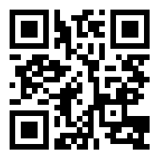
Presentation and source code of the demonstration
https://bit.ly/2pEWE8o

Slide 17
Useful links
Take control of multi-platform push notifications with Azure Notification Hubs
Azure Notification Hubs overview
Devices registration management
Azure Notification Hubs Frequently asked questions

Slide 18

Vivien Chevallier
Feel free to contact me if you have questions about this presentation
http://www.vivien-chevallier.com
vivien@vivien-chevallier.com
http://twitter.com/vchevallier
http://www.linkedin.com/in/vivienchevallier

