Slide 1
Take control of multi-platform push notifications with Azure Notification Hubs
Wednesday, February 7, 2018
Montreal Mobile .NET Developers
Microsoft Montreal
Vivien Chevallier

Slide 2
Summary
Sending push notifications
Azure Notification Hubs, main features of the service
Configuration and deployment
Practical part, use case and demonstration

Slide 3
Sending push notifications

Slide 4
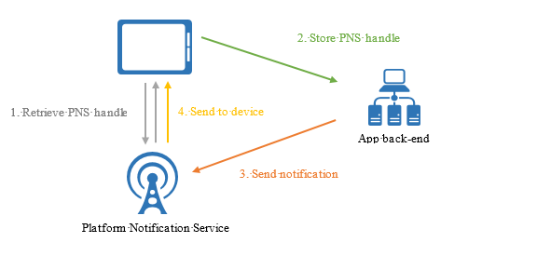
Principle
Sending push notifications

Slide 5
Sending push notifications
Write your own library
Use a third party library; Ex: PushSharp
Complexity increasing with the number of platforms
Take maintenance into account (Platforms change)
Scalability of the implementation
Support fast scalability

Slide 6
Azure Notification Hubs

Slide 7
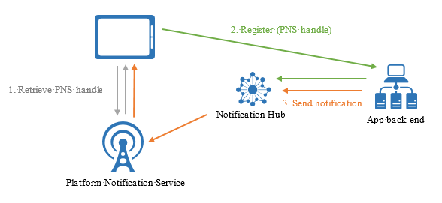
Principle
Azure Notification Hubs

Slide 8
Main features of the service
Azure Notification Hubs
Multi-plateform
Apple iOS, Android, Windows Universal, Windows Phone, Kindle, Baidu, Xamarin (iOS & Android), Chrome Apps et Safari
One API call = notifications to 1 or multiple platforms
Cloud or On-premise
Send 1 million push notifications per minute

Slide 9
Main features of the service
Azure Notification Hubs
Free
  1 million push notifications per month
  500 registered devices
SDK for the following les platforms: .NET, Java, PHP, Python and Node.js

Slide 10
Devices registration
Azure Notification Hubs
From the device itself
From the backend
Benefits of registering from the backend
  More control
  User Authentication
  Create or modify tags according to the application logic

Slide 11
Devices registration
Azure Notification Hubs
Via Registration or Installation
Installation is now prefered, most recent and effective way
No risk of duplication in the device registration
Easier to target a specific device with the tag $InstallationId
An installation contains:
  Id
  Platform
  Handle PNS (PushChannel)
  Tags

Slide 12
Devices registration
Azure Notification Hubs
Tags help target users
Allow to easily associate metadata to a device
Tag expression: AND (&&), OR (||), NOT (!)
Example :
  Country, New user
  (Canada || USA) && !NewUser

Slide 13
Configuration and deployment

Slide 14
Configuration and deployment
Via the portal
  https://portal.azure.com/
Via ARM Template
  Deploying Azure Notification Hub with ARM template

Slide 15
Practical part, use case and demonstration

Slide 16
Scenario
Practical part, use case and demonstration
I use Azure WebJobs et would like to know the status of the jobs that are running, whether they have been completed successfully or if they could not be completed.
I would like to receive notifications on my Android phone to know the status of the jobs.

Slide 17
Solution
Practical part, use case and demonstration
API
  Register the token of the device
  Get available tags: JobsFailing and JobsSuccessful
  Get tags to which a device subscribed
  Update tags to which a device subscribed
WebJob
  Process a job when there is a message in a queue
  Send job status via Notification Hubs
Android Application
  Send the device token
  Subscribe to tags
  Receive notifications to know the status of the jobs

Slide 18
Demonstration

Slide 19
Q&A

Slide 20
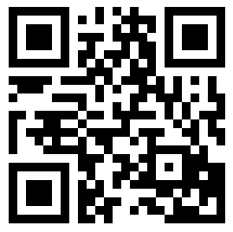
Presentation and source code of the demonstration
http://bit.ly/2EG7kek

Slide 21
Useful links
Take control of multi-platform push notifications with Azure Notification Hubs
Azure Notification Hubs overview
Devices registration management
Azure Notification Hubs Frequently asked questions

Slide 22

Vivien Chevallier
Feel free to contact me if you have questions about this presentation
http://www.vivien-chevallier.com
vivien@vivien-chevallier.com
http://twitter.com/vchevallier
http://www.linkedin.com/in/vivienchevallier

